Slide 1
Introduction
CS 3339
Review 1
Greg LaKomski
Texas State University
Fall 2018

Slide 2
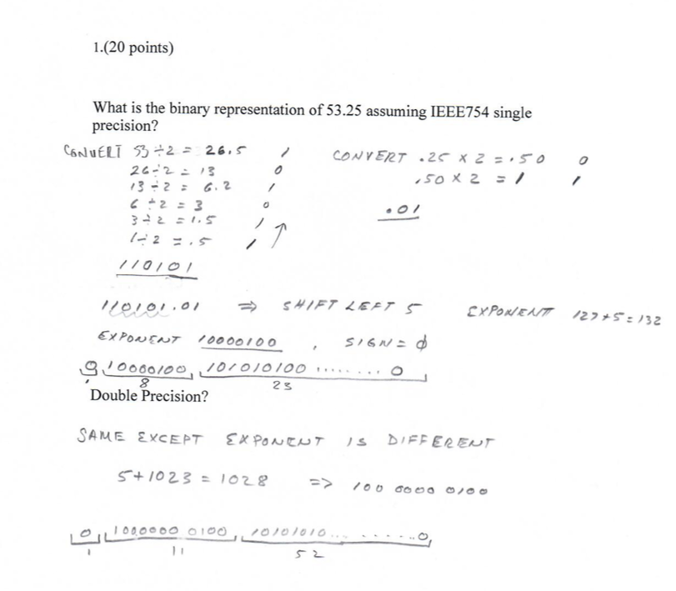

Slide 3
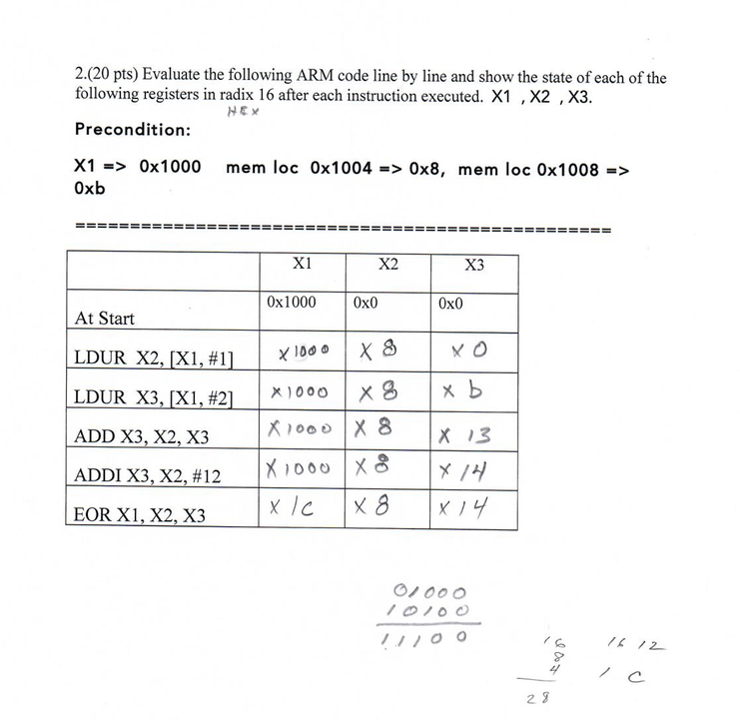

Slide 4
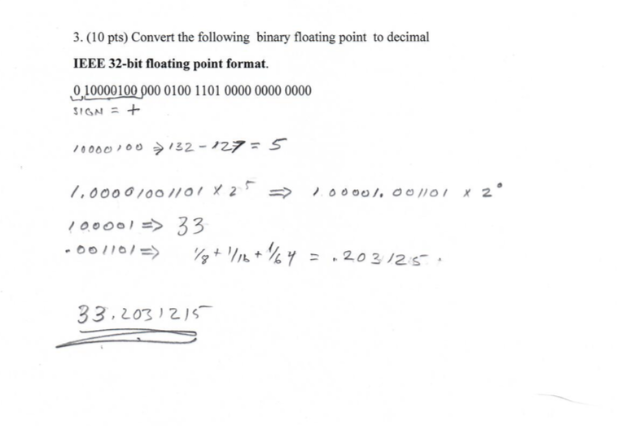

Slide 5
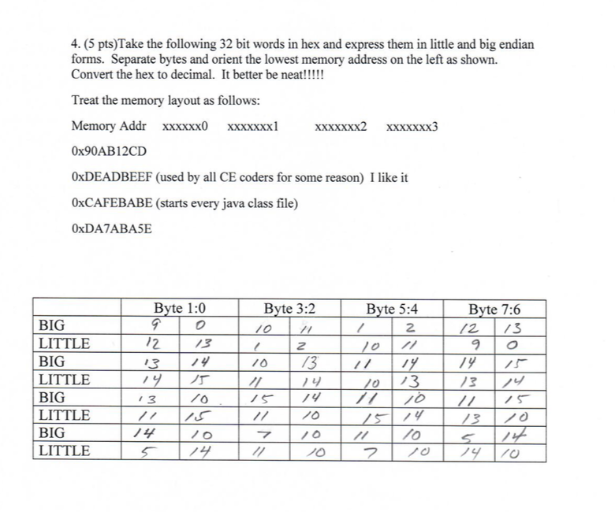

Slide 6
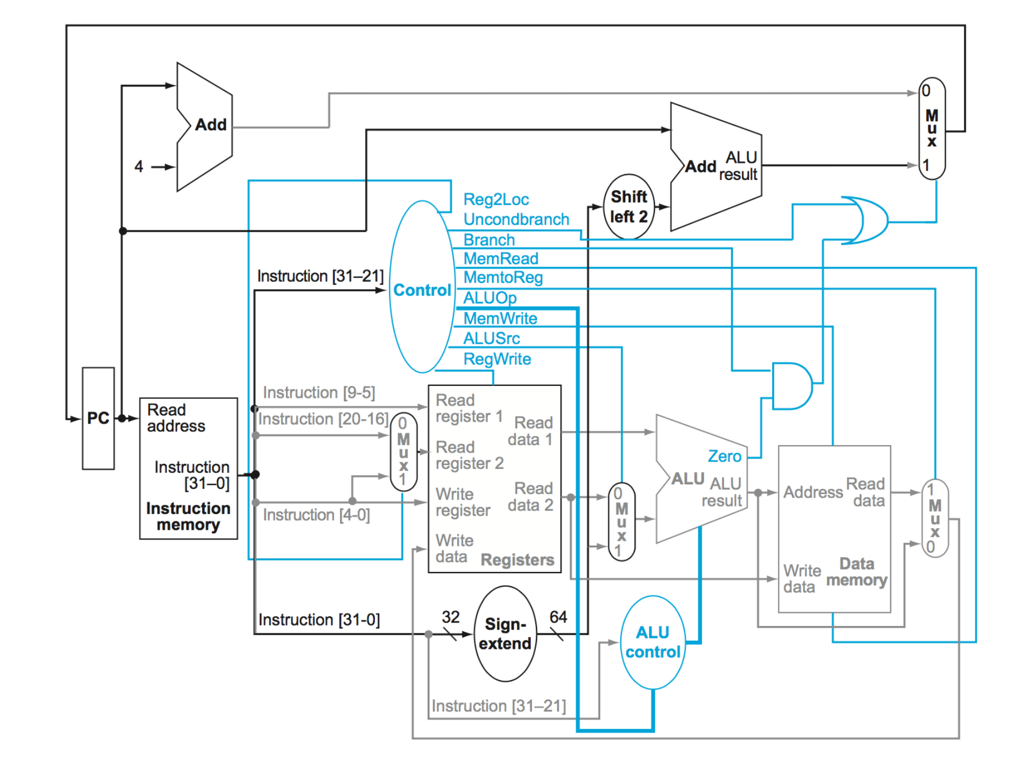
Unconditional Branch

Slide 7
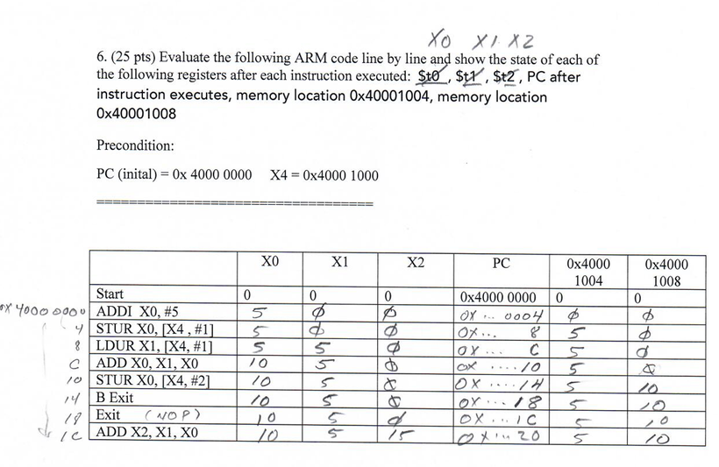

Slide 8
Academic Honesty
Do NOT cheat!
If I catch you cheating I will not be happy and I will utilize all options open to me to let you know just how unhappy I am.
http://www.txstate.edu/honorcodecouncil/Academic-Integrity.html.
Notes:
Choosing partners

Slide 9

Youre not going to cheat are you?

Slide 10
Evaluation
Homework 10%
On line exercises 7%
Projects 21%
Exam 1 21%
Exam 2 21%
Final 20%
Projects
Part 1 4%
Part 2 9%
Part 3 8%

Slide 11
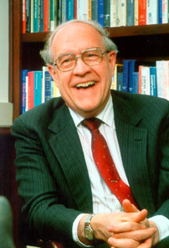
What Is Computer Architecture?
Computer architecture is the conceptual design and
fundamental operational structure of a computer system
- wikipedia
Computer architecture, like other architecture, is the art of determining the needs of the user of a structure and then designing to meet those needs as effectively as possible within economic and technological constraints
- Fred Brooks – IBM , Turing Award 1999

Slide 12
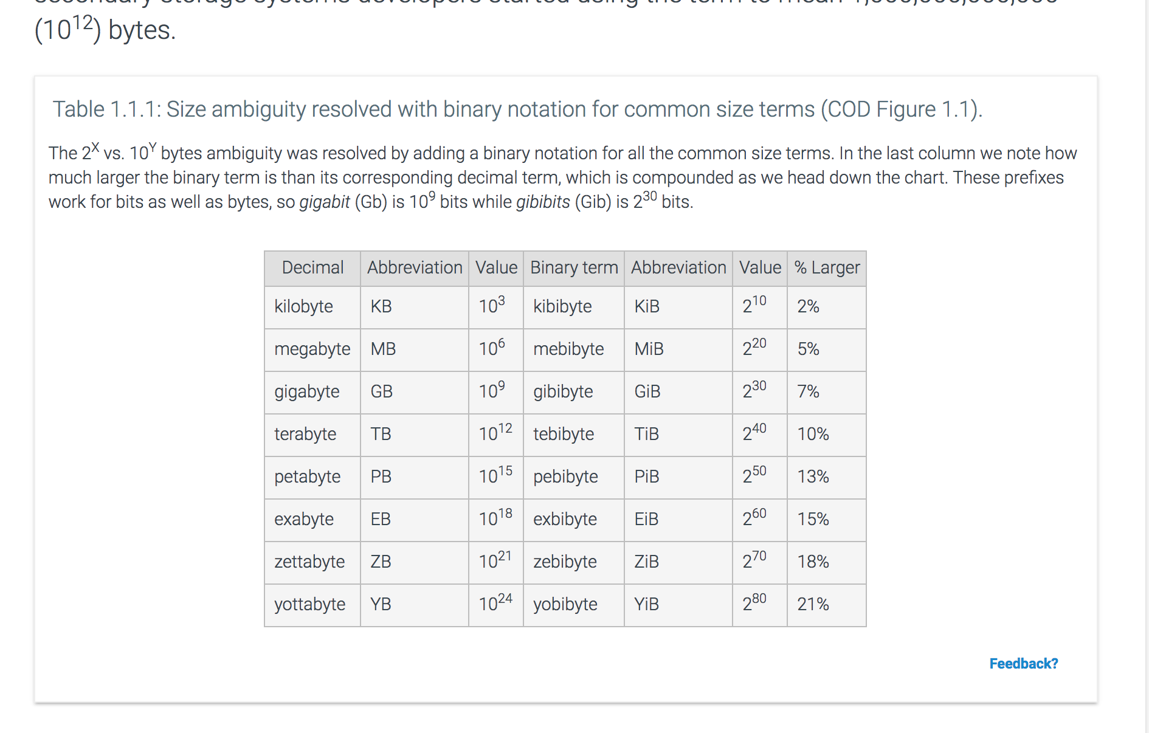
Size is Important
Add slides covering sections

Slide 13
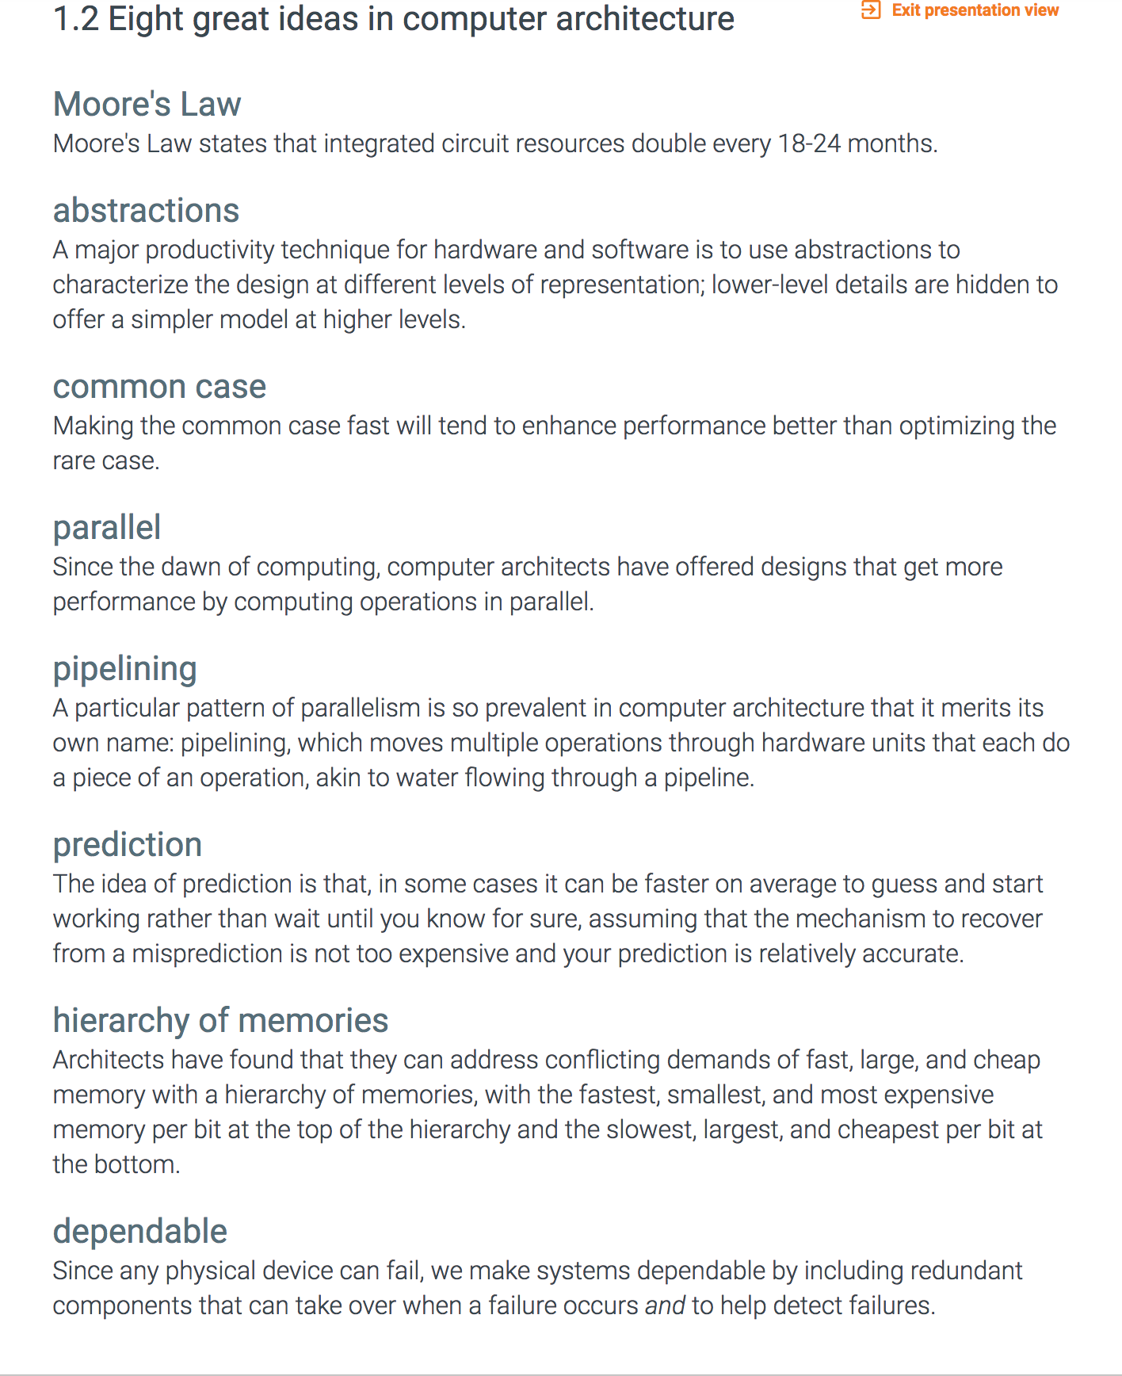
Eight Great Ideas

Slide 14
Performance Evaluation
What metrics / things to look at?
Execution Time of a task
Throughput
Clock Cycles
CPI - aka clock cycles per instruction
Instruction Count
Computer Architecture
Compiler
Task Characteristics – CPU,IO,Memory
Effective CPI
Bottlenecks
Relative Performance
Compared to what? Another system? A specification? A standard?

Slide 15
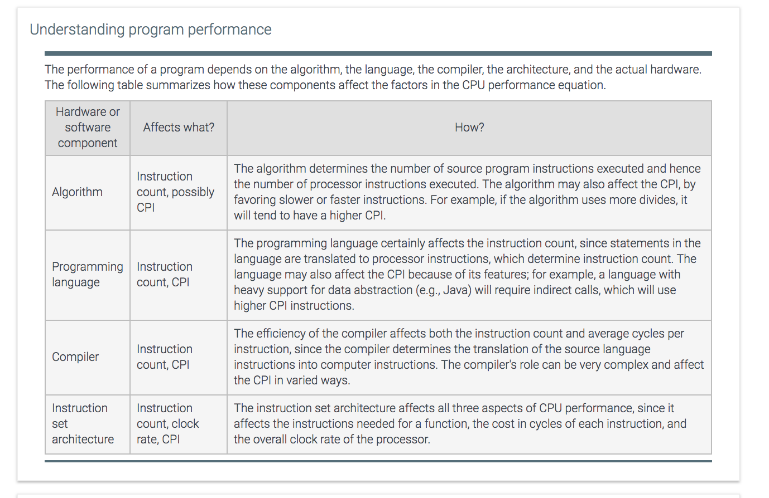
Performance Evaluation

Slide 16
Execution time
Execution time:
the time between the start and the completion of a task

Slide 17
Throughput
Throughput
# of tasks per unit time
total amount of work done in a given time
Throughput = # of processes completed / time
Throughput = # of pages served / time
Decreasing execution time almost always improves throughput

Slide 18
Clock Cycles
Every computer has a clock that ticks
Length of a clock tick is referred to as a clock cycle
Clock cycle is the minimum unit of time that the system can measure
Also the unit of time when an event can occur
Clock cycle on modern machines measured in picoseconds (10⁻¹²) ( 1 TeraHertz)
The smaller the clock cycle, the faster the machine
one clock period
Notes:
A clock cycle is the basic unit of time to execute one operation/pipeline stage/etc.

Slide 19
Clock Rate
Number of ticks per second
measured in GHz (or formerly MHz)
advertised processor speed
computed as the inverse of clock cycle
Clock Rate = 1 / Clock Cycle (in seconds)
Examples:
10 nanosec clock cycle => 1/10 x 10⁻⁹ = 1/10⁻⁸ = 10⁸ = 100 MHz clock rate
1 nanosec (10⁻⁹) clock cycle => 1 GHz (10⁹) clock rate
500 psec clock cycle => 2 GHz clock rate
250 psec clock cycle => 4 GHz clock rate
200 psec clock cycle => 5 GHz clock rate
Notes:
Clock Rate is inverse of clock cycle time

Slide 20
CPU Execution Time
# of clock cycles = # of cycles program is busy doing work on the CPU
Can improve performance by:
Reducing either the length of the clock cycle – IF YOU CAN!
comes from Moore’s Law (technology)
Based on what you now know – what limit exists here????
Reducing number of clock cycles required for a program
Architecture
Compiler
OS
Notes:
Equation on page - cpu execution time is equal to the number of cpu clock cycles for a program divided by the clock rate of the processor seconds equal cycles divided by cycles per second

Slide 21
Effective CPI
Computing the overall effective CPI is done by looking at the different types of instructions and their individual cycle counts and averaging
n
Overall effective CPI = Σ (CPI_{i} x IC_{i})
i = 1
Where IC_{i} is the count (percentage) of the number of instructions of class i executed
CPI_{i} is the (average) number of clock cycles per instruction for that instruction class
n is the number of instruction classes
The overall effective CPI varies by instruction mix – a measure of the dynamic frequency of instructions across one or many programs

Slide 22
Example : Effective CPI
Op | Freq | CPI_{i} | Freq x CPI_{i}
ALU | 50% | 1 | 0.5
Load | 20% | 5 | 1.0
Store | 10% | 3 | 0.3
Branch | 20% | 2 | 0.4
 |  |  | Σ = 2.2
Will talk about types of instructions later
Notes:
For lecture

Slide 23
Effective CPI
Remember that I showed you examples of improving CPI????
Understand why the examples do what they do!
Get it????

Slide 24
Execution Rate
Measured in instructions per second
1/cycles per instruction * cycles per second
Number of Cycles = cycles/second * seconds
Number of Instructions = number of cycles /CPI

Slide 25
Another Equation for CPU Time
OR
These equations separate the three key factors that affect performance
The clock rate is usually given
Can measure overall instruction count by using profilers/ simulators without knowing all of the implementation details
CPI varies by instruction type and ISA implementation for which we must know the implementation details

Slide 26
Remember: There Are No Absolutes!
Absolute performance often doesn’t say much
It takes 300 milliseconds to launch Skype on MacBook Pro
Program X runs on platform Y in Z seconds
Need a baseline to measure relative performance
This ratio is called the speedup
If X takes half as long to run as Y on platform Z, we say we achieve a factor of 2 speedup over Y
Speedup > 1 is good, < 1 is bad, never 0
If X is n times faster at something than Y, then (the something is very important)
Notes:
Increasing performance requires decreasing execution time. Equation is ratio of performance of x to performance of y is equal to the ratio of the execution time of y to the execution time of x.

Slide 27
Words
8 bits is a byte
16 bits used to be a “word” no longer
32 bits is a word
64 bits is a double word
Warning: I expect you to know all this in your sleep
Additionally – A character is 4 bits – a nibble
Memory location address holds a byte – 8 bits
Four locations make up a word!
So two characters are in a byte

Slide 28
Adding Binary
0 + 0 = 0
1 + 0 = 0 + 1 = 1
1 + 1 = ?
= 0 carry 1
1+1+1 = 1 carry 1
0111 + 0111 = 1110
7 + 7 = 14

Slide 29
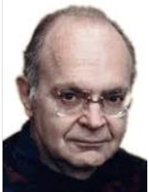
Who is Donald Knuth???
Look it up. He is important!

Slide 30
Shifting a number left is the same as multiplying
The processor can shift left way faster than multiplying
So when you code you need to know this!
We will talk about shift registers, adders, and multiplication later.
What are the three kinds of shifts?
LSL
RSL
RSA

Slide 31
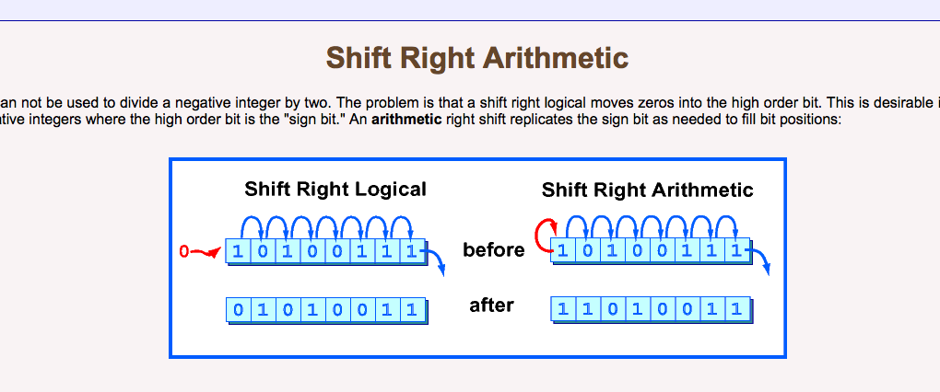
RSA

Slide 32
Workloads and Benchmarks
Benchmarks
Especially selected programs used to compare performance
Programs that represent real applications
Workloads
A set of programs that represent a collection of applications that may be run on a system in a given period of time
Use of benchmarks and workloads not ideal, but it’s the best we have
Distinct from the verb ‘benchmark’

Slide 33
Need To Have Realistic Expectations
Cannot expect an enhancement in one aspect to have a proportional improvement on overall performance
Assume a program runs for 10 seconds. It spends 2 seconds on disk I/O. If we built a disk that transfers data at the speed of light (!), what kind of speedup would we get?
Speedup = ExecTime_{old}/ExecTime_{new} = 10/8 = 1.25
Notes:
Speed up equals old execution time over new execution time

Slide 34
Estimating Potential Speedup
The amount of performance improvements achieved depends on two factors
how good is the enhancement (s)
how often is the enhancement used (p)
Speedup due to enhancement
ExTime_{new} = (ExTime_{old} * p * 1/s) + (ExTime_{old} * (1 – p))
ExTime_{new} = ExTime_{old} * ((1 – p) + p/S)
Speedup = ExTime_{old}/ExTime_{new} = 1/((1-p) + p/s)

Slide 35
Example : Estimating Potential Speedup
Assume FP instructions are improved by a factor of 2. But
only 10% of instructions are FP. What is the speedup in the
new architecture?
Here,
p = 0.1
s = 2
ExTime_{new} = ExTime_{old} * [(1 – p) + p/s]
= ExTime_{old} * (0.9 + 0.1/2)
= ExTime_{old} * 0.95
Speedup = 1/0.95 = 1.053
Notes:
Example of speedup where the part you sped up is only ten percent of the all instructions

Slide 36
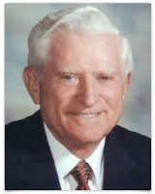

Amdahl’s Law
Achievable speedup is bounded by the amount that the improved feature is used
Implications?
To get most bang for your buck make the common case fast
Notes:
Picture of gene amdahl

Slide 37
ARM ISA

Slide 38
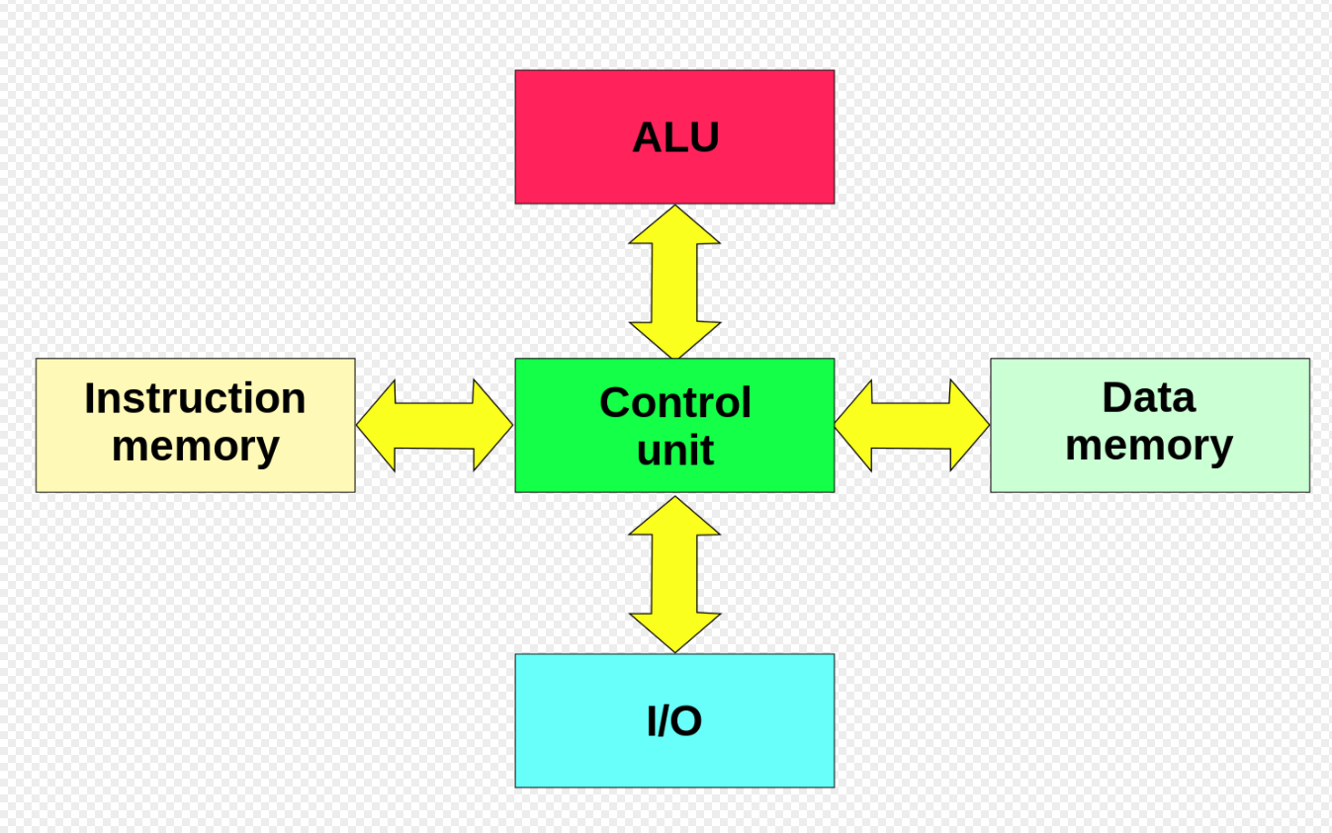
Harvard Architecture

Slide 39
Classic Von Neumann Architecture
Input
Device
Memory
CPU
Output
Device
Notes:
Graphic showing IO, memory, cpu, output device

Slide 40
ISA Design Goals
Data types
Operations
Interrupts/Events
Instruction formats
Addressing modes
…
instruction
Op
Mode
r1
r2
Machine
State
Machine
State
execution
Before
After
Notes:
Change instruction to match ARM layout

Slide 41
Machine State
Registers
Size/Type
accumulators
index registers
general registers
control registers
Memory
Visible hierarchy (if any)
Addressability
byte, word, bit
byte order (endian-ness)
maximum size
protection/relocation
Program Counter or Instruction Pointer
PC
Memory
Byte addr
Registers
R0-R31
Little Endian
64-bit addr
32 bit
Machine State ARM
Notes:
Shows the machine state is defined by what’s in memory, what’s in the registers, and what’s in the program counter

Slide 42
Endianness from wikipedia
Endianness refers to the sequential order used to numerically interpret a range of bytes in computer memory as a larger, composed word value. It also describes the order of byte transmission over a digital link. Words may be represented in big-endian or little-endian format, depending on whether bits or bytes or other components are numbered from the big end (most significant bit) or the little end (least significant bit). When addressing memory or sending/storing words bytewise, in big-endian format, the most significant byte, which is the byte containing the most significant bit, is sent first (has the lowest address) and the following bytes are sent (or addressed) in decreasing significance order with the least significant byte, which is the byte containing the least significant bit, thus being sent in last place (and having the highest address). Little-endian format reverses the order of the sequence and addresses/sends/stores the least significant byte first (lowest address) and the most significant byte last (highest address). The order of bits within a byte or word can also have endianness (as discussed later); however, a byte is typically handled as a numerical value or character symbol and so bit sequence order is obviated

Slide 43
Instruction Classes
For most architectures, instructions can be grouped into three classes
ALU operations
Control Flow
Data Movement
Consider instructions in programming languages …

Slide 44
Instruction Encoding
Similar across many ISAs
Operations or opcodes
Number of operands
Operand values or which register to get the values
Operand specifiers
Which one is source which one is destination
add $1, $2, $3
opcode
src1
src2
dst
10001011000
00010
00011
00001
Notes:
Need to add ARM opcode

Slide 45
Variable-length Instruction Encoding
Use only the bits that is required for each instruction
Variable-length instructions give more efficient encodings
no bits to represent unused fields/operands
Examples
VAX-11, Intel x86 (byte variable)
Intel 432 (bit variable)
Can make fast implementation difficult
sequential determination of location of each operand
8
Op
8
4
4
Op
R
M
8
4
4
4
4
4
4
Op
R
M
R
M
R
M
8
4
4
32
Op
R
M
Disp
VAX instrs: 1-53 bytes!
Will revisit this issue when we discuss instruction decoding
Notes:
Illustrations of variable length instructions on vax

Slide 46
Multi-length Instruction Encoding
Compromise and choose
Gives much better code density than fixed-format
important for embedded processors
Simple to decode
Examples:
ARM Thumb, MIPS 16
Another approach
On-the fly instruction decompression (IBM CodePack)
6
5
5
5
1
10
Op
R1
R2
R3
Const
6
5
5
Op
R1
R2
4
4
4
4
Op
R1
R2
R3
Notes:
Illustration of multi length instructions. Point is that it has better code density which makes it good for embedded.

Slide 47
Instruction Encoding Variations – Fixed Length – That’s us folks!
Different instructions need to specify different types of information
return
increment R1
R3 ← R1 + R2
jump to 64-bit address
Frequency varies
instructions
constants
registers
Can encode
fixed format
small number of formats
byte/bit variable
How long should an instruction be?
Notes:
Change this slide over to ARM formats

Slide 48
Instruction Encoding Variations – Fixed Length – That’s us folks!
11
5
6
5
5
R: Rd ← Rn op Rm
Opcode
Rm
Shamt
Rn
Rd
11
9
2
5
5
D: ld/st: Rt← Rn [Address]
Opcode
Address
Opcode2
Rn
Rt
10
12
5
5
I: Rd← Rn + Immediate
Opcode
Immediate
Rn
Rd
There are more!
32 bits ☺
rev 2
Notes:
Corrected Error in D instruction to 11 bits – rev2 9/2018

Slide 49
More
B 6 bit opcode – 26 bit word offset
CB I’m not going to tell you , na na na
IM

Slide 50
Signed Binary Representation
32-bit signed numbers (2’s complement): 0000 0000 0000 0000 0000 0000 0000 0000_{two} = 0_{ten} 0000 0000 0000 0000 0000 0000 0000 0001_{two} = + 1_{ten} ...
0111 1111 1111 1111 1111 1111 1111 1110_{two} = + 2,147,483,646_{ten} 0111 1111 1111 1111 1111 1111 1111 1111_{two} = + 2,147,483,647_{ten} 1000 0000 0000 0000 0000 0000 0000 0000_{two} = – 2,147,483,648_{ten} 1000 0000 0000 0000 0000 0000 0000 0001_{two} = – 2,147,483,647_{ten} ...
1111 1111 1111 1111 1111 1111 1111 1110_{two} = – 2_{ten} 1111 1111 1111 1111 1111 1111 1111 1111_{two} = – 1_{ten}
MAXINT
MININT
MSB
LSB
Converting <32-bit values into 32-bit values
copy the most significant bit (the sign bit) into the “empty” bits 0010 -> 0000 0000 … 0000 0010 1010 -> 1111 1111 … 1111 1010
sign extend versus zero extend

Slide 51
Binary Shift
A binary shift has the effect of multiplying or dividing a number by 2
Left shift implies multiplication
Right shift implies division
The bit that is shifted is “lost”
This can be avoided if we allocate larger storage (e.g., 64-bit register instead of 32) and put the value in the top/bottom half
shift left w/ 0
0100 => 1000
shift right w/ 0
0100 => 0010

Slide 52
Overflow
Overflow occurs when the result of an operation cannot be represented with the number of bits in the destination register
e.g. operands are 32 bits, result is > 32 bits
Overflow can occur
For integer and floating point operations
For signed and unsigned operations
For addition, subtraction, multiplication, division
Section 2.5.5 has table of how to detect for addition and subtraction

Slide 53
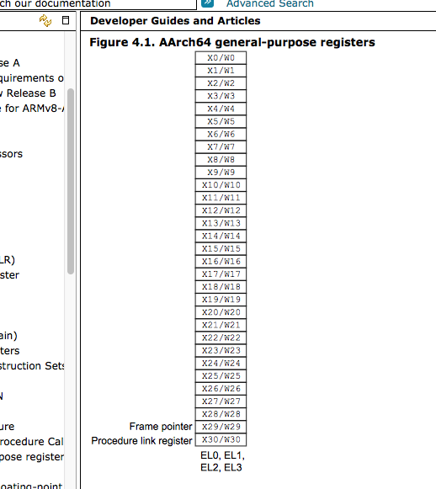
Registers

Slide 54
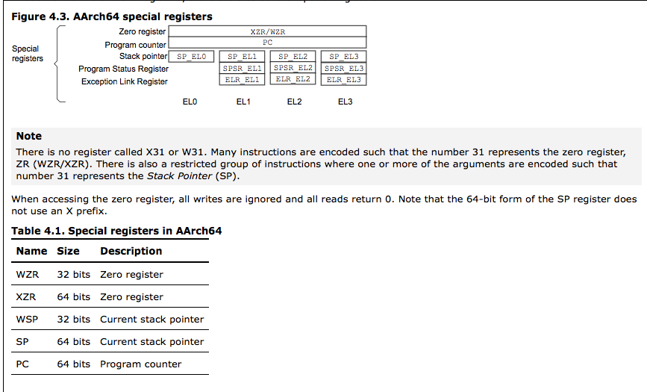

Slide 55
Addressing Modes
PC-Relative Addressing This is used in the CBZ and CBNZ (branch equal, branch not equal) instructions. A form of “Base” addressing where the base is the PC. In ARM the B instruction is PC Relative
Register Addressing: This is used in the (branch register) BR instruction.
Base Addressing This is used in the STUR and LDUR (load register, store register) instructions.
We are not using immediate addressing ( I think)

Slide 56
PC Relative Addressing
Most common form of indirect addressing is PC-relative addressing
Can use address of current instruction as base address
Current instruction stored in PC
Used by most modern architectures
This doesn’t solve problem with jumps entirely
What else can change control-flow in programs and cause jumps?
Function calls
Code for a function may be far far away

Slide 57
Control Instruction Implementation
All control instructions need to update PC, so that it points to the next instruction to be executed
Implicit control on each instruction
PC = PC + 4
No explicit machine code needed
Need to implement
Unconditional jumps
Conditional jumps (or branches)

Slide 58
Base Addressing – Load / Store
Let's consider the following instruction.
LDUR rt, [rs, offset] load contents of base in $rs + se(offset) into $rt
where $rs and $rt are any two registers.
The offset is the 9 bit immediate value from the instruction. The 9 bits are the number of words we are offsetting.

Slide 59
Alignment
Some architectures restrict addresses that can be used for different-sized data transfers
Bytes accessed at any address
Half-words only at even addresses
Words accessed only at multiples of 4
This is called an alignment restriction
There are other types of data alignment issues that can affect performance
alignment with cache line boundaries
alignment of array starting addresses
Mainly the compilers responsibility
unaligned word access
byte address
0
1
2
3
4
5

Slide 60
Principles of ISA Design I
Keep it simple (KISS)
complexity
increases logic area
increases pipe stages
increases development time
evolution tends to make kludges
Orthogonality (modularity)
simple rules, few exceptions
all ops in all registers
Frequency
make the common case fast
some instructions (cases) are more important than others
Data Types
Regs
Operations
Formats
Add Modes
Slide courtesy : Doug Burger
Notes:
Graphics to try to illustrate Orthoginality

Slide 61
Floating Point

Slide 62
Scientific Notation
General format
(-1)^{sign} x F x 10E
F = fractional part
E = exponent
Fractional part usually normalized (e.g., 1.xxxx)
For binary, it becomes
(-1)^{sign} x F x 2E

Slide 63
Binary Representation of Floating-point Values
Allocate some bits for exponent, some for fraction, and one for sign
Still have to fit everything in 32 bits (single precision)
What is the trade-off?
S
Exponent
Fraction
31
0
Range vs. Precision
more bits in the fraction (F) gives more accuracy, more bits in the exponent (E) increases size of the number being represented

Slide 64
Floating-point Standard
Defined by IEEE Std 754-1985
Revised in 2008
http://en.wikipedia.org/wiki/IEEE_754-2008
Developed in response to divergence of representations
Portability issues for scientific code
Now almost universally adopted
Enforced at the language level
Two representations
Single precision (32-bit)
Double precision (64-bit)

Slide 65
Conversion
I expect you to know how to convert from decimal floating point to binary floating point and vice versa

Slide 66
Floating-point Addition in Binary
Addition (and subtraction)
(±F1 × 2^{E1}) + (±F2 × 2^{E2}) = ±F3 × 2^{E3}
Step 0: Restore the hidden bit in F1 and in F2
Step 1: Align fractions by right shifting F2 by (E1 - E2) positions
(assuming E1 ≥ E2)
Step 2: Add the resulting F2 to F1 to form F3
Step 3: Normalize F3 (so it is in the form 1.XXXXX …)
If E1 and E2 have the same sign check for overflow
If E1 and E2 have different signs check for underflow
Step 4: Round F3 and possibly normalize F3 again
if F3 has more bits then we have room for
Step 5: Re-hide the most significant bit of F3 before storing the result
8 x 2⁴ = 8/2 x 2³ = 4 x 2³
Divide by 2 ≈ right shift
Number too small!
Notes:
Note that the smaller fraction is the one shifted (while increasing its exponent until it is equal to the larger exponent)

Slide 67
Floating point math
I expect you to know how to divide to decimal floating point numbers
ie 3 x 10² / 6 x 10⁴ = WHAT?

Slide 68
Data Path

Slide 69
Floating-point Addition in Binary
Addition (and subtraction)
(±F1 × 2^{E1}) + (±F2 × 2^{E2}) = ±F3 × 2^{E3}
Step 0: Restore the hidden bit in F1 and in F2
Step 1: Align fractions by right shifting F2 by (E1 - E2) positions
(assuming E1 ≥ E2)
Step 2: Add the resulting F2 to F1 to form F3
Step 3: Normalize F3 (so it is in the form 1.XXXXX …)
If E1 and E2 have the same sign check for overflow
If E1 and E2 have different signs check for underflow
Step 4: Round F3 and possibly normalize F3 again
if F3 has more bits then we have room for
Step 5: Re-hide the most significant bit of F3 before storing the result
8 x 2⁴ = 8/2 x 2³ = 4 x 2³
Divide by 2 ≈ right shift
Number too small!
Notes:
Note that the smaller fraction is the one shifted (while increasing its exponent until it is equal to the larger exponent)

Slide 70
Processor Datapath and Control
Datapath and Control combine to provide a processor implementation
elements are connected through wires
only means of communication
need to think in binary!
Each element in the datapath and the control unit has corresponding hardware
We will not use an HDL in this class
HDLs work best at a lower abstraction level
Hardware Descriptive Language - Verilog
We will use diagrams (like the one in the next slide) to understand the design and implementation issues

Slide 71
Instruction Fetch
ADD
Increment by 4 for next instruction
4
PC
read port
<
instruction
read
address
Instruction
Memory
(L1 I-Cache)
Can send instruction address and compute next instruction in parallel
Specialized adder more efficient than regular ALU
Notes:
Block 1 for Edgar

Slide 72
Instruction Execution
The tasks involved in instruction execution can be generalized as follows
Fetch
Decode
Execute
Depending on instruction class
Use ALU to calculate
Arithmetic result
Memory address for load/store
Branch target address
Access data memory for load/store
Fetch next …
A
Fetch-Decode-Execute Loop
A

Slide 73
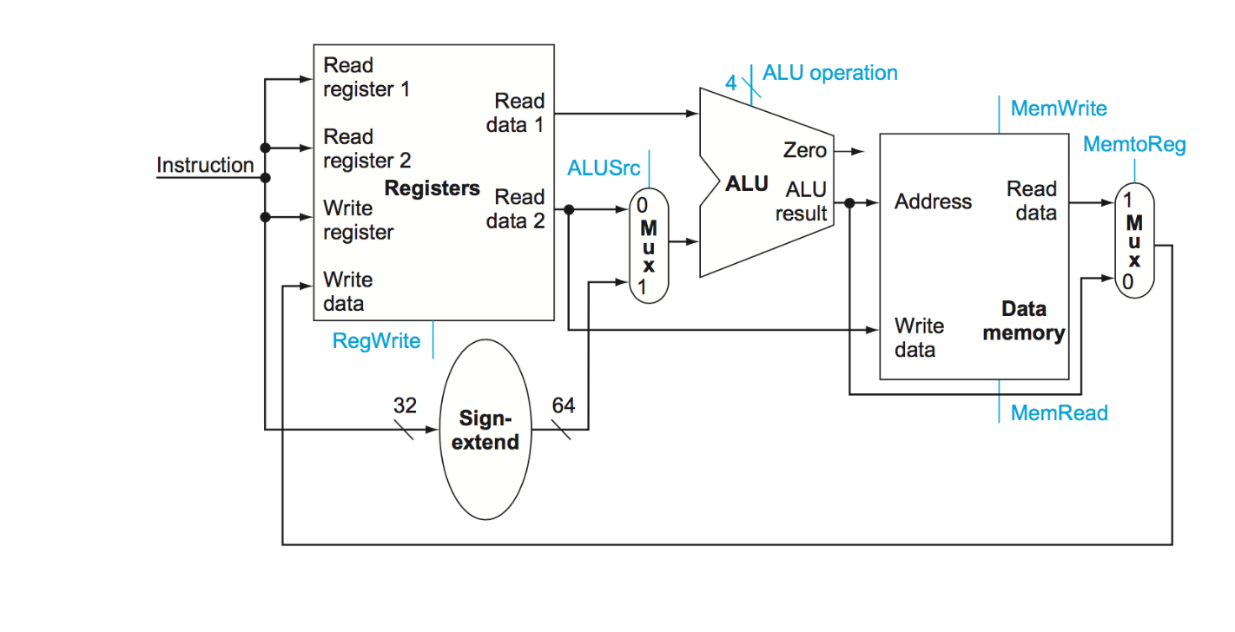
Data Path for R and D instructions

Slide 74
Control for “MATH”
0
0
0
1
0

Slide 75
Control for LD
0
1
1
1
1

Slide 76
Control for ST
1
0
1
0
0

Slide 77
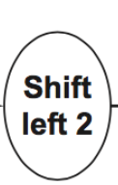
Conditional Branch Instructions
Read register operand
Compare operand to condition
Calculate target address
Sign-extend offset
Shift offset left 2
Add to PC + 4
oper
offset in words
comp
CBZ, CBNZ
Read
Addr 1
Read
Data 1 <
Read
Addr 2
Register
File
Write
Addr
Read
Data 2 <
> Write Data
Shift throws away only sign bits
since sign extended from 19 bits
PC
Sign
Extend
ALU

Slide 78
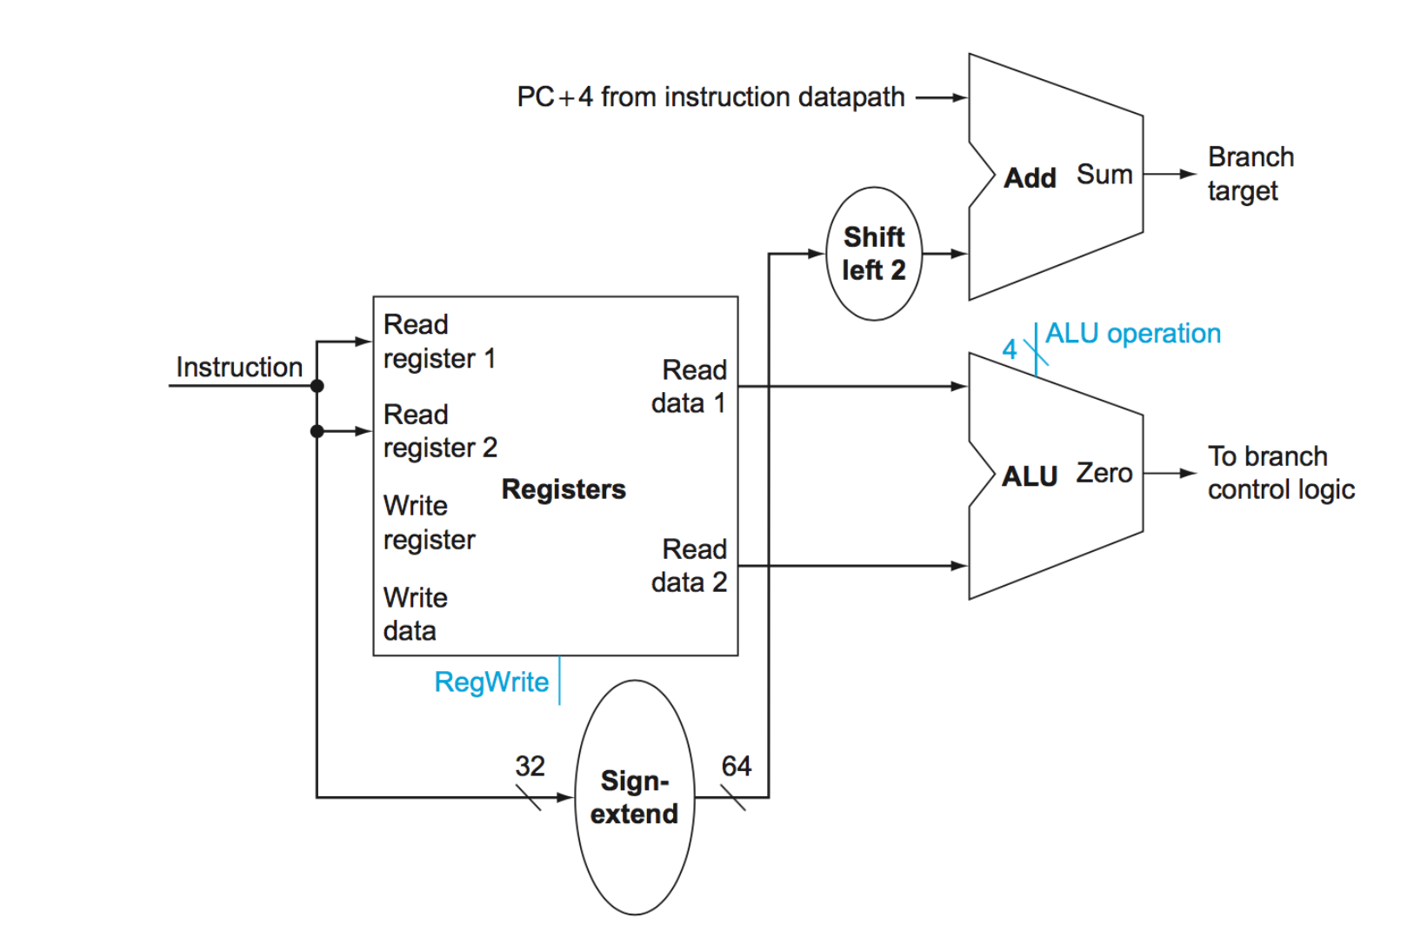
Implementing Conditional Branch

Slide 79
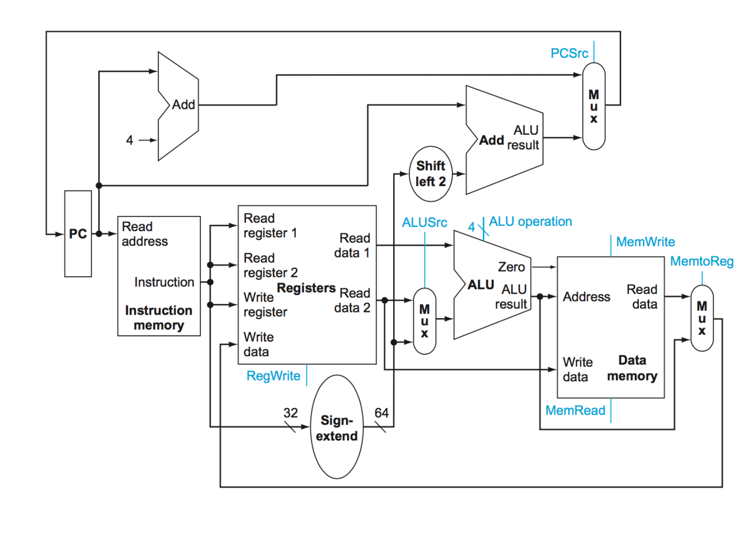
Putting the Elements Together

Slide 80
Control for CBZ
1
0
0
0
0
0

Slide 81
Single Cycle Cycle Time
The entire instruction is executed in a single cycle
Therefore the cycle must be as long as the longest instruction takes based on the electrical characteristics of the parts and pieces

Slide 82
Estimating Instruction Times
What is the clock cycle time, assuming
Instruction and Data Memory (200 ps)
ALU and adders (200 ps)
Register File access (reads or writes) (100 ps)
Assume negligible delays for muxes, control unit, sign extend, PC access, shift left 2, wires
Instr. | I Mem | Reg Rd | ALU Op | D Mem | Reg Wr | Total
ALU
LD
ST
CBZ
B
200 | 100 | 200 |  | 100 | 600
200 | 100 | 200 | 200 | 100 | 800
200 | 100 | 200 | 200 |  | 700
200 | 100 | 200 |  |  | 500
200 |  |  |  |  | 200

Slide 83
Putting the Elements Together

Slide 84
What is missing?
I Instruction:
That is an easy one to visualize. The 12 bit immediate from the instruction has to be formatted to be able to be part of the math instruction and then fed to the ALU.
What formatting do we have to do?
BR Instruction:
This one is a bit tricky since we have to pipe the entire address in the register to the PC
B Instruction:
This instruction requires taking the B offset adding it to the PC.
What’s the issue with just using the exact same hardware as the conditional branch instructions?

Slide 85
Key Thing to Understand
The “wires” from the instruction memory unit are hooked up at the same time to several things. Which wires do what is a function of controlling the muxes.

Slide 86
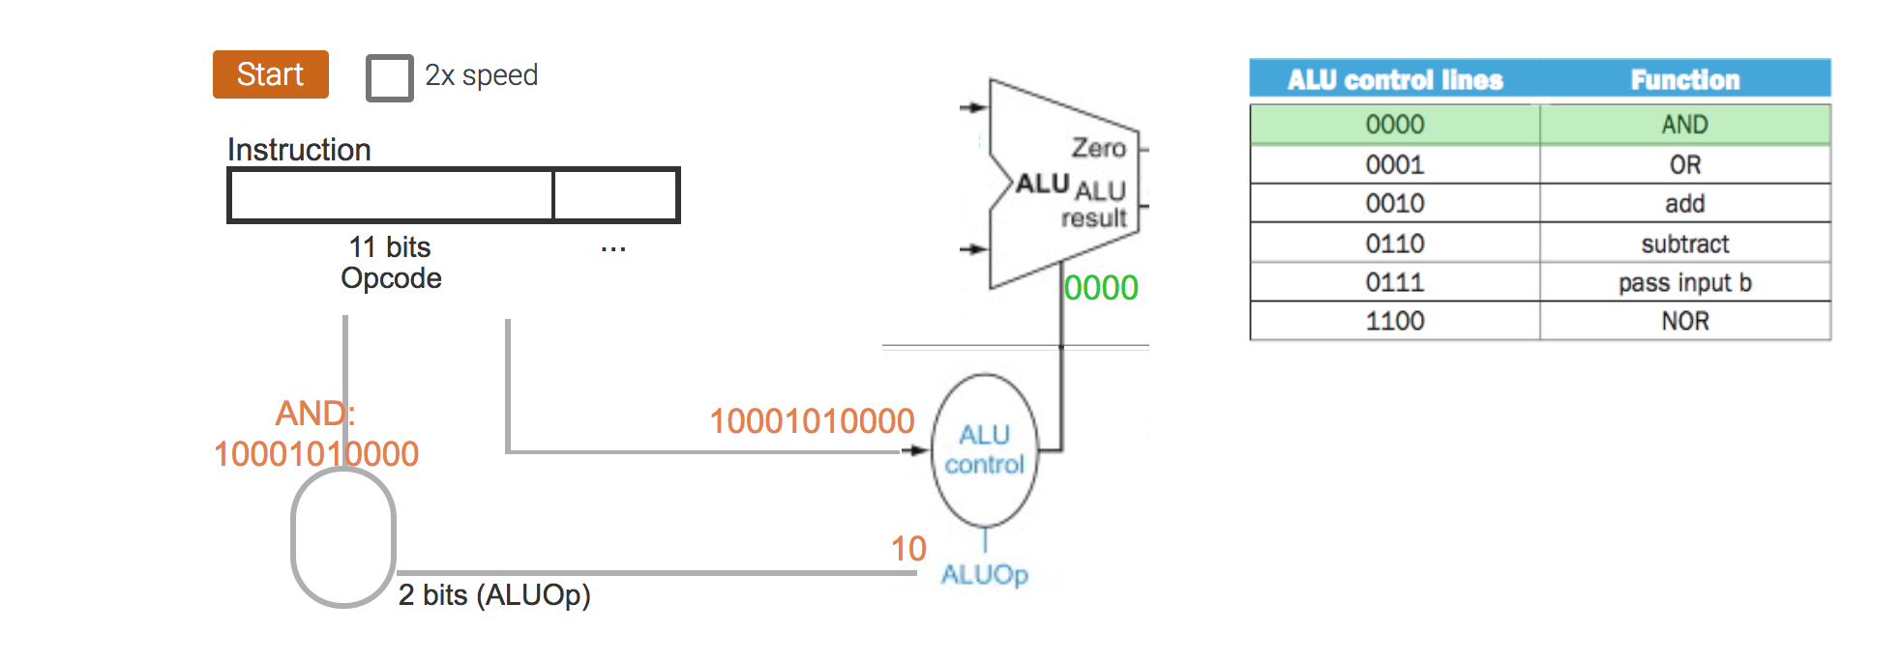
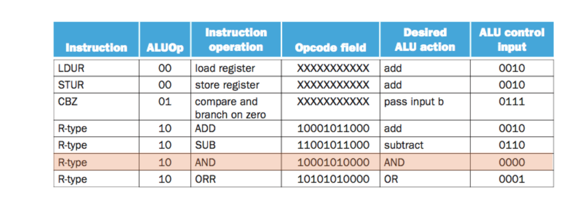
Example R instruction

Slide 87
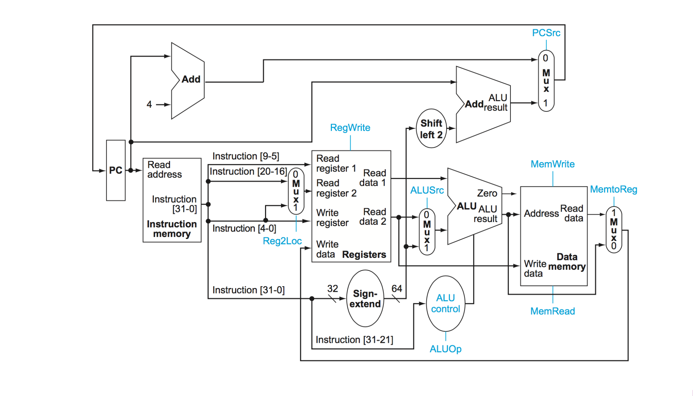
We add muxes to allow selecting which bits for what

Slide 88
Unconditional Branch

Slide 89
Good Luck
I have not written it yet so don’t ask
If you have read the zybook and done the exercises and done the homework and listened to the lectures versus watching football and cat videos you will do fine

